Slide 1
C++ PROJECT PRESENTATION
BY GROUP 10
Team members:
Aryan Kashyap (20BAI10072)
Shishir Sharma (20BCE11007)
Zoya Qadri (20BCG10111)

Slide 2
VITX UNIVERSITY STAFF RECORD
Topics covering:
Data abstraction
Constructor and Destructor
Inheritance
Friend function
Templates
File handling
IOStream Manipulators
Error/ exception handling
Compile time polymorphism
Function Overloading
Operator Overloading
Runtime Polymorphism
Virtual Functions

Slide 3
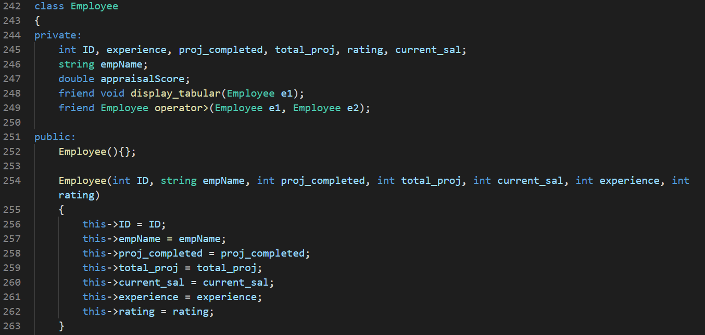
DATA ABSTRACTION
It refers to providing only essential information about the data to the outside world, hiding the background details or implementation.

Slide 4
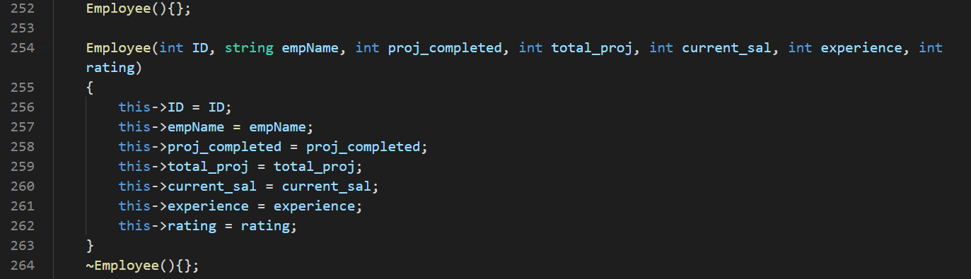
CONSTRUCTOR AND DESTRUCTOR
Constructor initializes values to object members after storage is allocated to the object.
Destructor is used to destroy the class object.

Slide 5
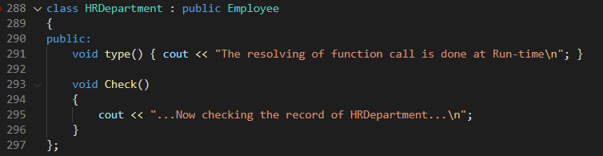
INHERITANCE
The capability of a class to derive properties and characteristics from another class.

Slide 6
FRIEND FUNCTION
A friend class can access private and protected members of other class in which it is declared as friend. It is sometimes useful to allow a particular class to access private members of other class.
A friend function can be:
a) A member of another class
b) A global function

Slide 7
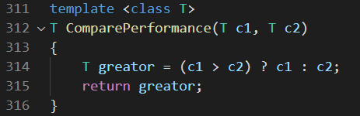
TEMPLATES
Templates are features of C++ which allow us to write generic programs, i.e we can create a single function or a class to work with different data types using templates.

Slide 8
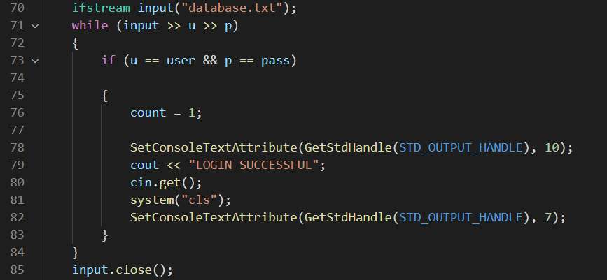
FILE HANDLING
It provides a mechanism to store the output of a program in a file and to perform various operations on it.

Slide 9
IOSTREAM MANIPULATORS
In C++, files are mainly dealt by using three classes fstream, ifstream, ofstream.
C++ provides us with the following operations in File Handling:
Creating a file: open()
Reading data: read()
Writing new data: write()
Closing a file: close()

Slide 10
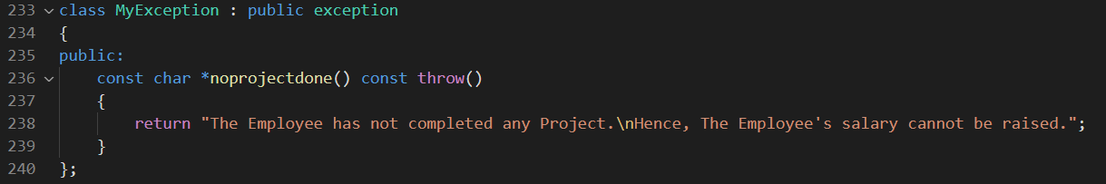
ERROR/EXCEPTION HANDLING
Exceptions provide a way to transfer control from one part of a program to another. C++ exception handling is built upon three keywords: try, catch, and throw.

Slide 11
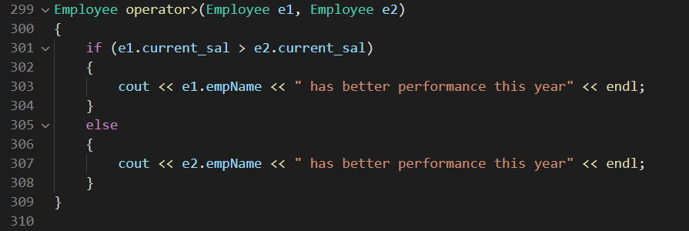
COMPILE TIME POLYMORPHISM
Whenever an object is bound with their functionality at the compile time, this is known as compile time polymorphism.
It can be implemented through function overloading and operator overloading

Slide 12
RUNTIME POLYMORPHISM
Whenever an object is bound with the functionality at runtime, it is known as runtime polymorphism.
VIRTUAL FUNCTION:
A virtual function is a member function that is declared within a base class and redefined by a derived class.

Slide 13
THANK YOU FOR YOUR ATTENTION

